Slide 1
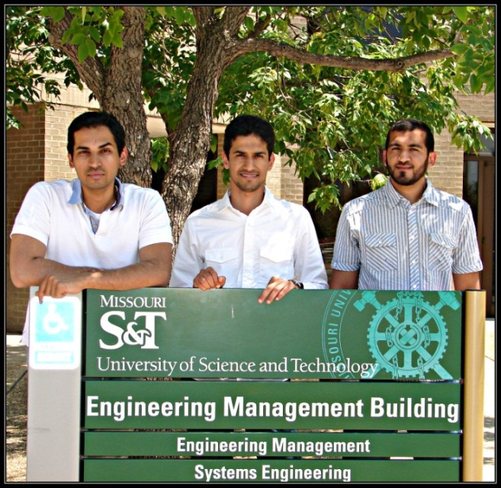
Office of International Affairs
King Saud University students at Missouri S&T for Applied Engineering Management Program
The program offers graduate degrees in Engineering Management to professionals in Saudi Arabia.
Students attended a summer class and engaged in cultural activities.
The Dean of Graduate Studies at King Saud University visited campus on July 12th to discuss further enhancements to our partnership.
“The program exceeded my expectations!”
– Omar Al-Suhaibani,
pictured (center) with Abdullah Al-Mogarri (l) and Najai Al-Johani (r).

Slide 2
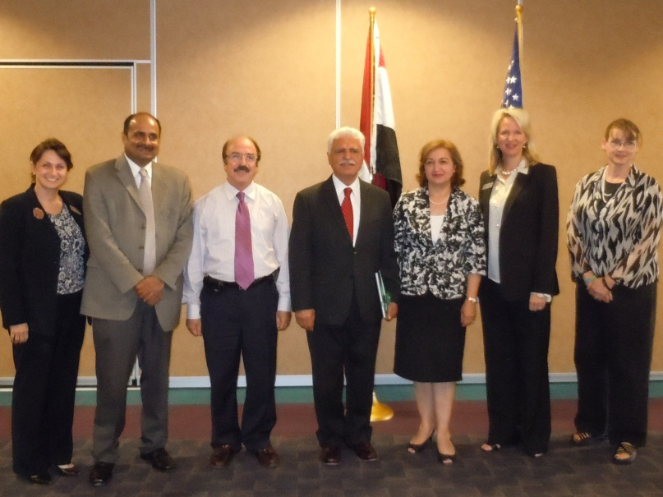
Office of International Affairs
The Iraqi Cultural Attaché, Dr. Abdul Hadi Alkhalili,
visited campus August 22, 2012 to meet current students
and discuss increasing the number of scholarships
available for Iraqi graduate students at Missouri S&T.

Slide 3
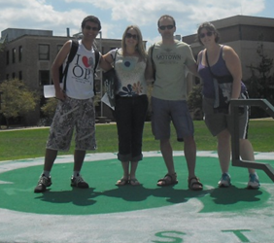
Office of International Affairs
Missouri S&T welcomed 12 undergraduate students sponsored by Brazil’s Science Without Borders Program and international exchange students with an on campus scavenger hunt on August 14th.
Missouri S&T will be sending 11 students to study abroad for the fall semester 2012.

Slide 4
Enrollment Management
Fall 2012 enrollment is up slightly. New records set with the numbers for female and minority students.
Search is underway for a new Director of Student Financial Assistance.
Student Success Center opening this fall in Toomey Hall.

Slide 5
Academic Affairs
ASSESSMENT/ ACCREDITATION
On August 20, 2012 we received official notification that the S&T off-campus Electrical and Civil Engineering Degree Programs at Missouri State University have been accredited by ABET to September 30, 2015.
Prof. Steve Raper (Engineering Management) has accepted the position of Special Assistant to the VPAA for ABET Accreditation Self Study and Site Visit Coordination.
CURRICULUM
New Degree Proposals Status:
BAMS (Bachelor of Arts in Multidisciplinary Studies) proposal was approved by the Board of Curators and now goes to CBHE.
I/O Psychology Master’s Degree proposal has been formally submitted to UM Academic Affairs.

Slide 6
Office of Sponsored Programs
Summary of FY12 activities and a year-over-year comparison are as follows:
Proposals awarded in total dollars: $24.7M (down 42.8%)
Number of proposals awarded and amendments: 270 (down 7.5%)
Number of proposals submitted: 493 (down 0.6%)
Proposals submitted in total dollars: $151.4M (up 1.3%)
Research expenditures: $41.4M (down 9.7%)
F&A recovered: $6.8M (down 9.8%)
Number of active awards: 568 (down 4.2%)

Slide 7
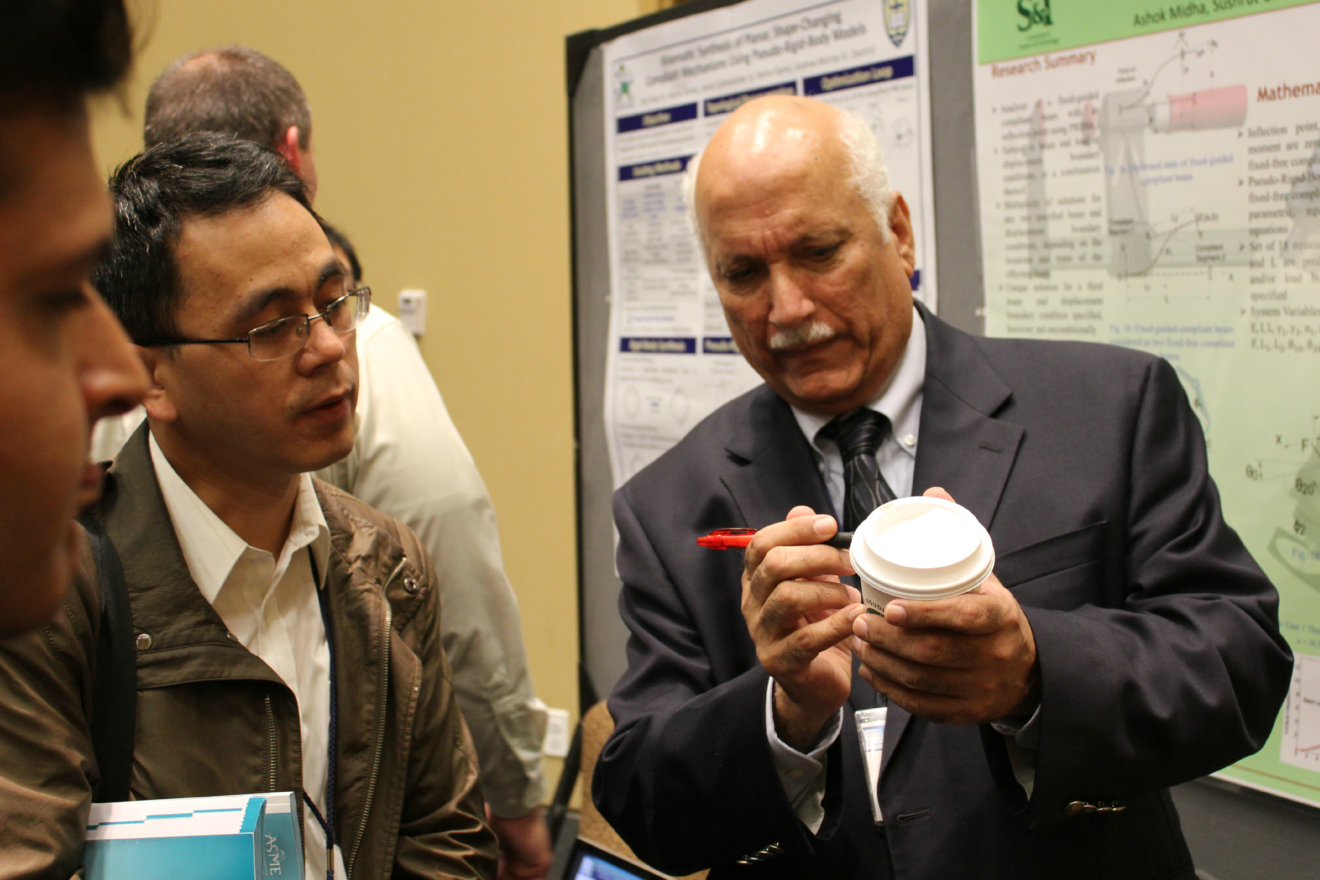
Congratulations to Dr. Ashok Midha
Beginning with the 2012 ASME Mechanisms and Robotics Conference, the Compliant Mechanisms Symposium is officially named the Ashok Midha
Symposium in Compliant Mechanisms, in recognition of Dr. Midha’s “pioneering contributions to this growing and fruitful research community,” and his “visionary leadership and generous support of the Compliant Mechanisms Awards.”
Notes:
Compliant mechanisms are those that derive some or all of their mobility from the deflection of constituent flexible members, and may involve large motions due to their structural deformation.
The advantages of compliant mechanisms include potential for increased design flexibility, ergonomics, assembly and manufacturability, with reduced part count and costs, need for lubrication, and shock and noise, among others.

Slide 8
Office of Undergraduate Studies
Honors Academy
Fall 2012 we have 262 enrolled in Honors Academy.
OURE
120 Students participating in the OURE program for 2012-2013
2 Students participating in the OURE Fellows program for 2012-2013
Undergraduate Research Day at the Capitol
Seeking Student Ambassadors for Undergraduate Research Day at the Capitol event http://ugs.mst.edu/ugrdc.html
Student Design & Experiential Learning Center
Formula SAE Team Returns From First European Competition
Solar House Ground Breaking Launches 2013 Home
Miners By Design Patron's Society Launched to Support the SDELC

Slide 9
Office of Graduate Studies
Graduate Resource Center is officially open and graduate guides began tutoring graduate students starting Sept. 1st week
Sponsored the PhD Movie Screening on Sept 7th in Butler-Carlton Bldg. with approx. 140 people in attendance.
Attended ORNL Grad Fair in August 2012 to recruit high quality graduate students.
Participated as a panel member in the Ingram’s Higher Education Industry Outlook assembly on Graduate Studies, Sept 6, 2012, Olathe, KS.

Slide 10
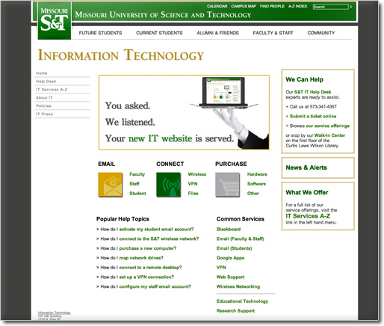
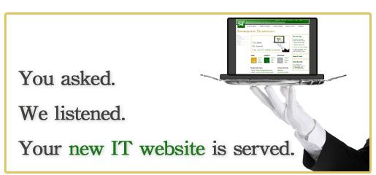
Information Technology
IT Website Optimization
Full site refresh during Summer 2012
Click current homepage banner for a brief tour of key features
http://it.mst.edu

Slide 11
Information Technology
Classroom and CLC Updates
All CLC and classroom computers (~940 PCs)
Windows 7 now installed
166 computers upgraded in CLCs
Virtual CLC environments moved to production status; user testing underway
Data Center Upgrade
Main data center: Power and HVAC upgrades
Benefits
Allow significantly increased capacity
Restored HVAC redundancy
Support disaster recovery site for UM system enterprise systems

Slide 12
Information Technology
S&T IT Conferences
2nd Annual S&T Research Technology Day
Held September 18, 2012 … a success!
6th Annual S&T Teaching and Learning Technology (TLT) Conference
Scheduled for March 14-15, 2013
Theme: Assessments – From Syllabus to Final
Keynotes: Dr. Rich Felder, Dr. John Hogan

